Slide 1



Maximizing The Digital Dividend.

Slide 2



ABOUT US
HiPipo is keen to promote secure digital financial services because of their vital role in promoting financial inclusion.
We work with FinTechs, women in tech, developers, MFIs, MNOs, Banks, DFSPs, regulators, policy makers, government, political, economic, and social systems and institutions.
We support early-stage FinTech companies and work on ecosystem initiatives in the FinTech arena and thereafter promote the most innovative trends.

Slide 3

HiPipo’s Community Activities
40 days 40 FinTechs Initiative #40Days40FinTechs #LevelOneProject
FinTech Landscape Exhibition #LevelOneProject
Women in FinTech Hackathon #WomenInFinTech #LevelOneProject
Women in FinTech Summit #WomenInFinTech #LevelOneProject
8th Digital and Financial Inclusion Summit #IncludeEveryone #LevelOneProject
8th Digital Impact Awards Africa #DIAA2021 #LevelOneProject

Slide 4
KEY HIGHLIGHTS
Market women traders Panel discussion, the first ever of its kind. 11th Dec 2020.
Discussion on the National Payments Systems Act 2020
High wholesale costs of products and this closes the rails to all players on an unequal basis that limits innovation and adaption of new and emerging technologies.
We observed the increasing need for single real-time payment solution, such as Mojaloop.
Small business owners are hungry for a real-time payment solution as their lives and businesses depend on day to day income.
Various initiatives in the innovation and FinTech space are struggling to move to an active phase due to endless discussions about practices, regulations, and aggregation.

Slide 5
Elected co-chair of the Community Council!
I am especially delighted to announce that I, Innocent Kawooya, was on Dec 17, 2020, voted as Co-Chair of the Mojaloop Community Council. This comes quickly on the heels of my being voted onto the Council itself a few weeks before that date. The members of the Council are all eminent in the field of financial inclusion and greatly knowledgeable about the direction the world should take as the goal for 100% achievement of the same is pursued.
It is a fantastic opportunity for me to learn and share and contribute amongst peers I greatly admire. It is also a validation of the tremendous work I and the HiPipo team continue to put in as we endeavour to create a fully digitised world where all citizens can access networks, financial and otherwise, to make their lives and those of their families and communities better. I look forward to working on the Council in this esteemed, extra capacity, and promise to do so to the best of my ability. I thank you all for your continued support, & God bless.

Slide 6
COMMUNITY THOUGHTS ABOUT MOJALOOP
FEEDBACK | PERCENTAGE
Excited that we have an OSS to help on interoperability | 19 (46.3%)
Mojaloop will help us cut costs and develop interoperable payment solutions easily. | 21 (55.8%)
Very excited and thankful, Eager to learn more and see of how we can adapt and contribute, looking forward to learn more about the next steps. | 31 (75.6%)
We have started implementing something that can leverage Mojaloop to better serve our target customers. | 37 (86.3%)
Eager to contribute code and support community | 11 (26.8)

Slide 7
How better can I, you and HiPipo support the Mojaloop community?
WE NEED TO KEEP ADVOCATING FOR ADOPTION;
FinTechs
DFSPs
Central Banks/Government Offices
Aggregators
Systems integrators
SUPPORT IN GROWTH OF THE MOJALOOP COMMUNITY
Attracting more quality contributors/members
Promote increased community participation
Invite collaboration with inclusion-focused orgs

Slide 8
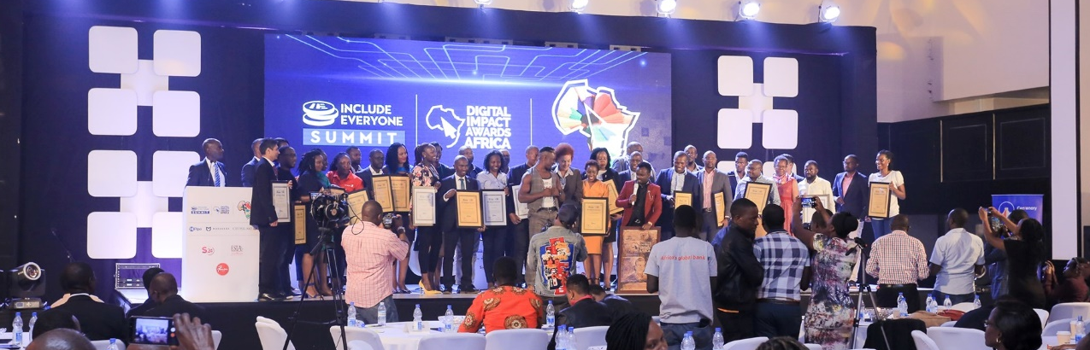
The annual research-based awards project celebrates and promotes the impact and excellence in products, services and innovations for Digital and Financial Inclusion.
We have seen several organizations adopt better digital and financial inclusion strategies having been challenged and inspired to improve as part of the summit and awards program.
In 2021, we aim at growing the event yearly, bringing together more stakeholders to celebrate and critic digital and financial inclusion innovations and development.

Slide 9
Digital And Financial Inclusion Summit | SUMMARISED
1 Day
32 Panelists
8 Hours on Live Online and National TV, NTV, and Smart 24 TV
We Made Main headlines on national news, UBC, NTV, Smart 24 TV
Numerous Online Articles, shining a spotlight on achievements in the digital arena and Our Partners Mojaloop Foundation, ModusBox, Crosslake Technologies, and Level One Project.
Sensitizing Stakeholders about interoperability and Level One project principles.
Risen hope for the stakeholders and excitement for interoperability solutions such as Mojaloop.

Slide 10
We greatly appreciate GOD and our partners including the Gates Foundation, ModusBox, Level One Project, Mojaloop Foundation and the United Nations Capital Development Fund.
Damali Ssali our Keynote Speaker will join me today, Steve Haley Joined us to speak on behalf of Mojaloop Foundation. Chris Lukolyo, Digital Country Lead, UNCDF
The Digital and Financial Inclusion summit is a great model for how to get the word out about on how FinTechs and all DFS stakeholders should be part of the Financial Inclusion solutions such Mojaloop, and especially FinTech conceptualized and built by women to solve for problems experienced by women.

Slide 11
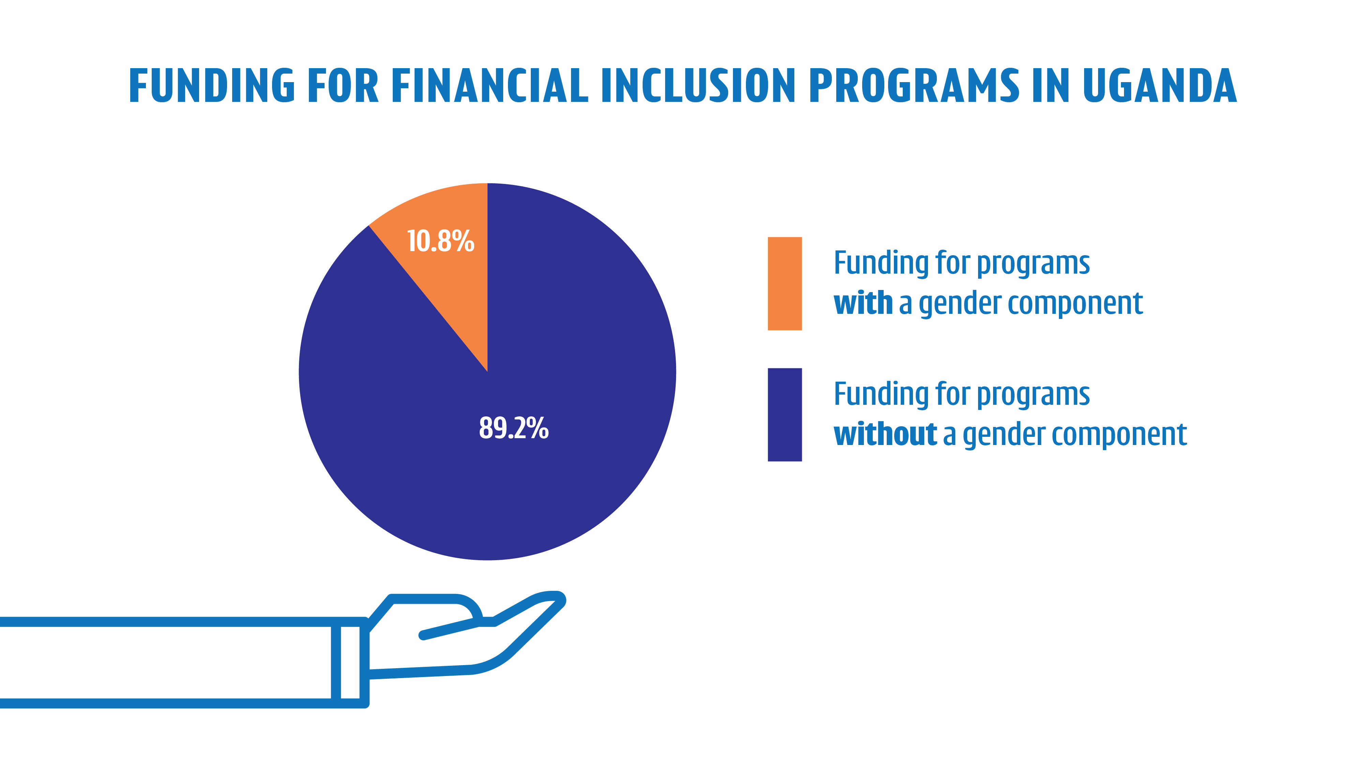
WE BORROWED SOME TEXT FROM CGAP

Slide 12

POLL
QUESTION
Do you think priority should be given to funding financial inclusion programs with a gender component?
Yes
No

Slide 13
Why it is so important to have initiatives like the HiPipo #IncludeEveryone program?
Promote innovation - without including everyone such as women innovators, we are only innovating with half our population!
We help players Build better products- By bringing every perspective into innovation space, especially FinTech, we build better products.
Manage Risk- better, thanks to the information resources available such as Level One Principles stake holders are helped to managed risks better.
Participants learn who the industry players are, both people and organizations - Who are the leaders to watch
Participants learn what is going on in the industry
How are regulations evolving?
Which organizations are innovating?
What is happening in other markets, which may influence our market?
We do capacity building for stakeholders such as FinTechs, MFIs, Saccos, Bankers, MNOs, Developers
Capacity building for market women traders in informal markets
Support Women in FinTech to play a role in getting more women into the financial space by generating interoperable financial inclusion solutions for women, by women.
We facilitate policy discussions with all stakeholders.

Slide 14
How more do participants benefit?
Find opportunities-
for individuals and their organizations;
Stakeholders share opportunities-
know who the rising stars are, when you are looking to hire
Find business partners, contractors, collaborators for projects, ventures, etc.
We encourage participants to;
Dream Big- “If not you, then who?”
Be Curious- Ask, read, learn, challenge, so they can enjoy life-long learning,
Be Resilient- In our careers, as well as our personal lives,
Manage their Reputation- Your reputation can be described as ‘what people say about you in your absence’.
We provide examples of practical application of Level One Principals
We provide mentorship sessions at every event
We provide ideation environment for product development
We provide opportunity for visibility and branding for promising pipeline products

Slide 15
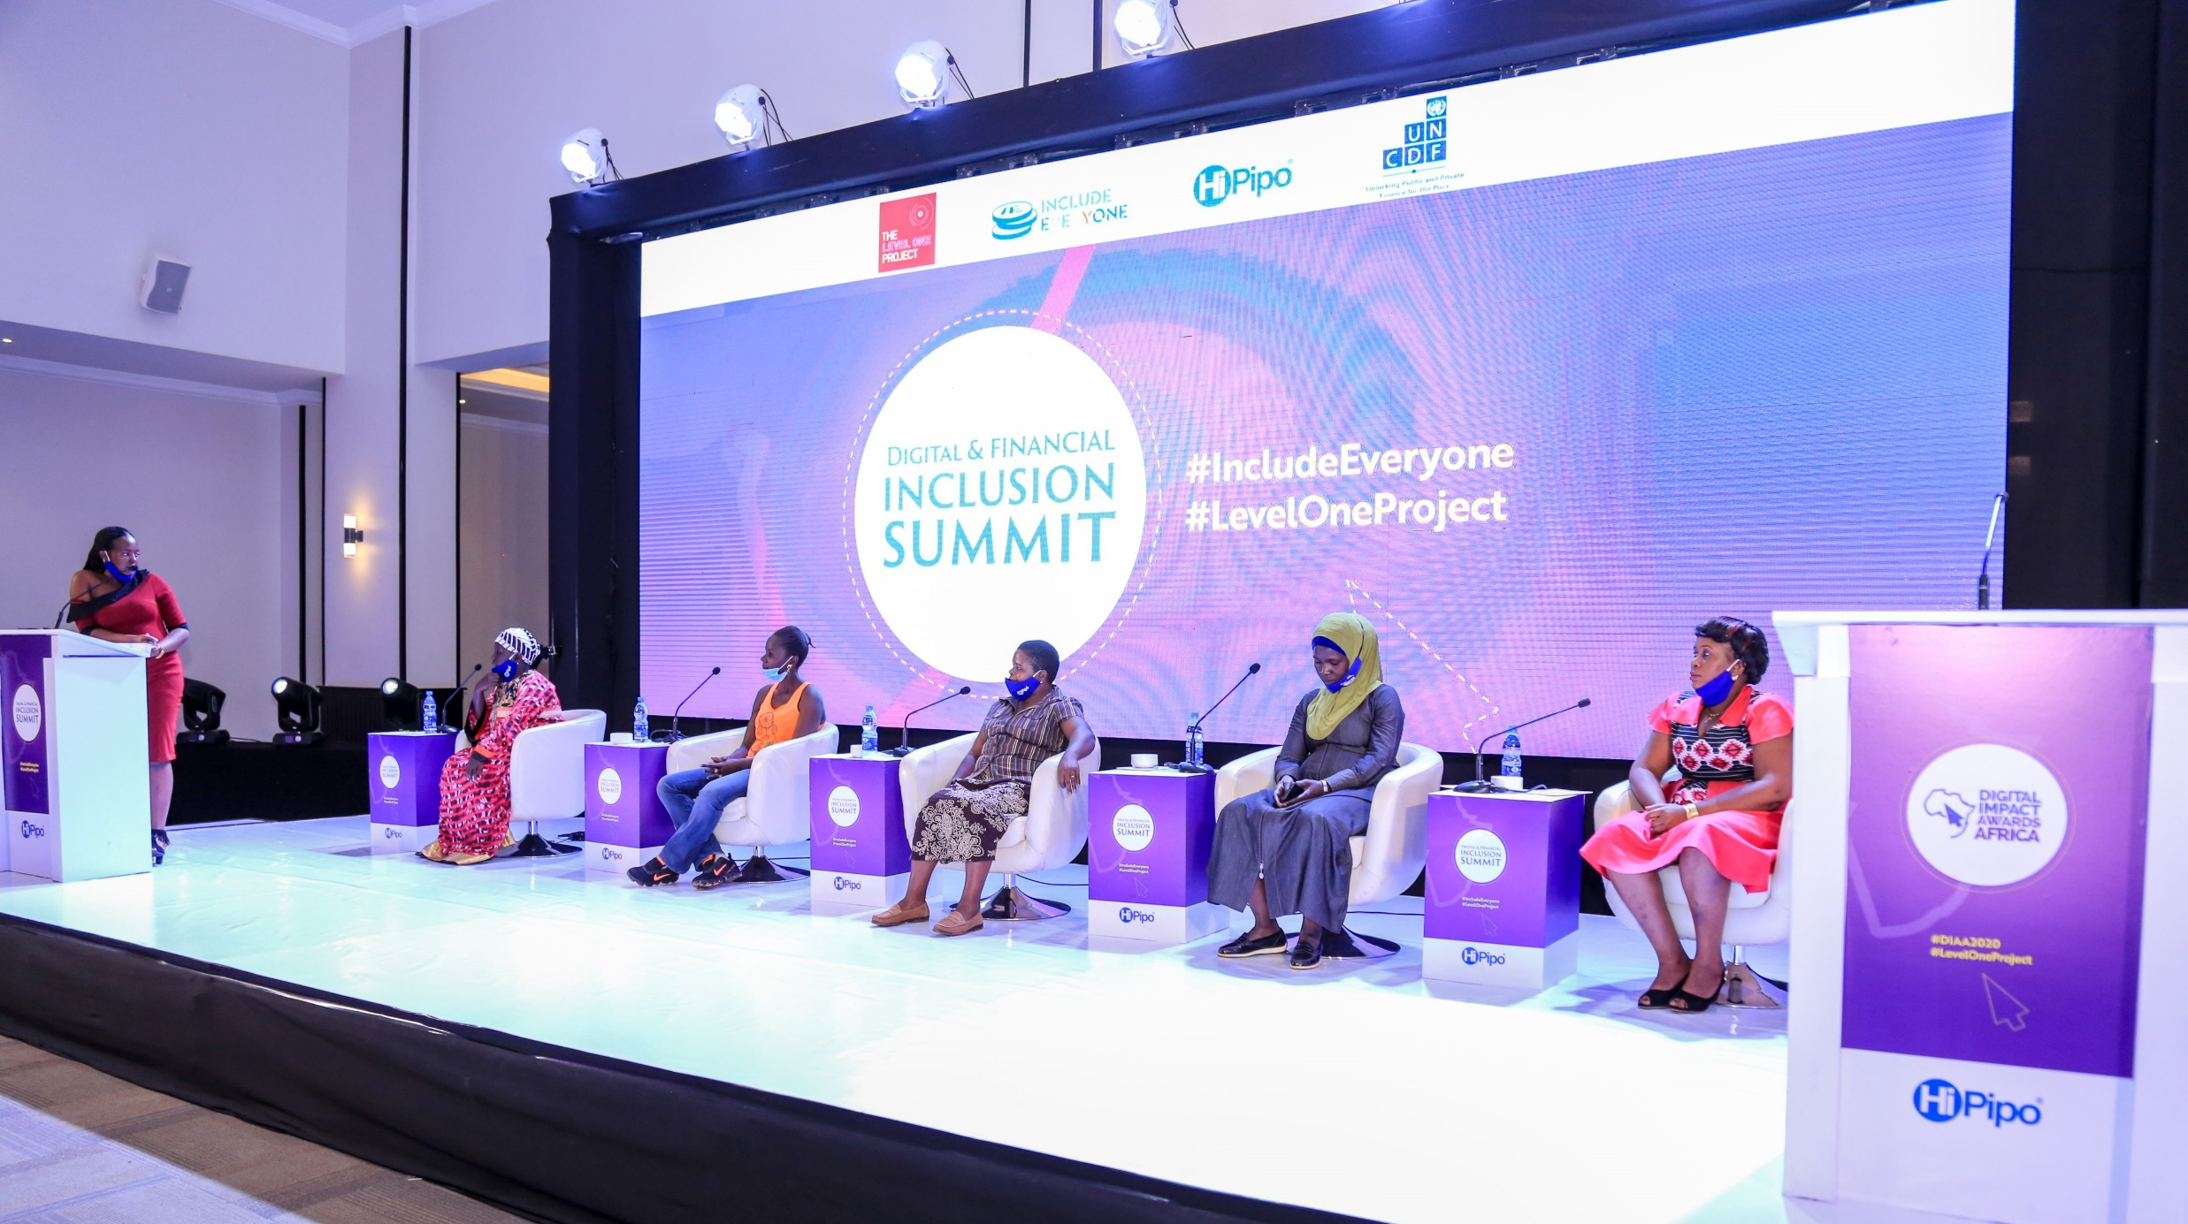
PANEL DISCUSSION OF WOMEN LEADERS IN INFORMAL MARKETS…...

Slide 16
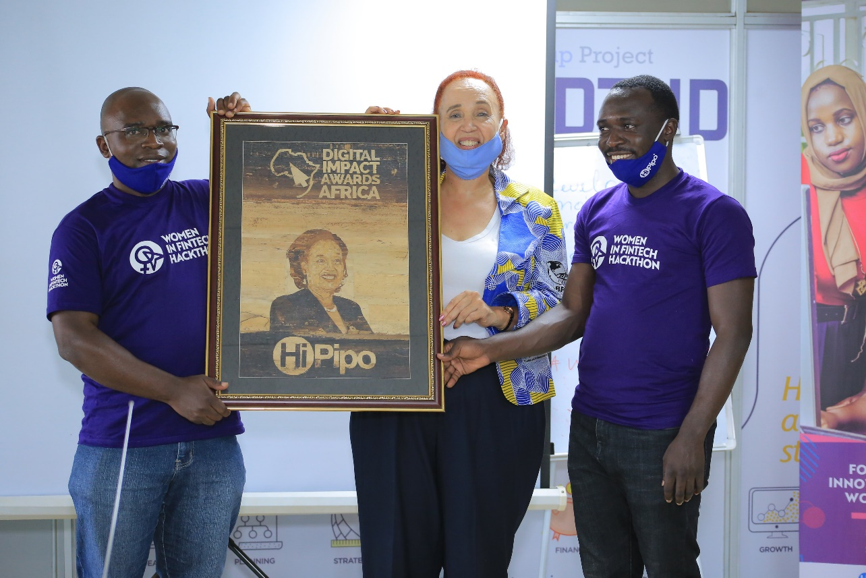
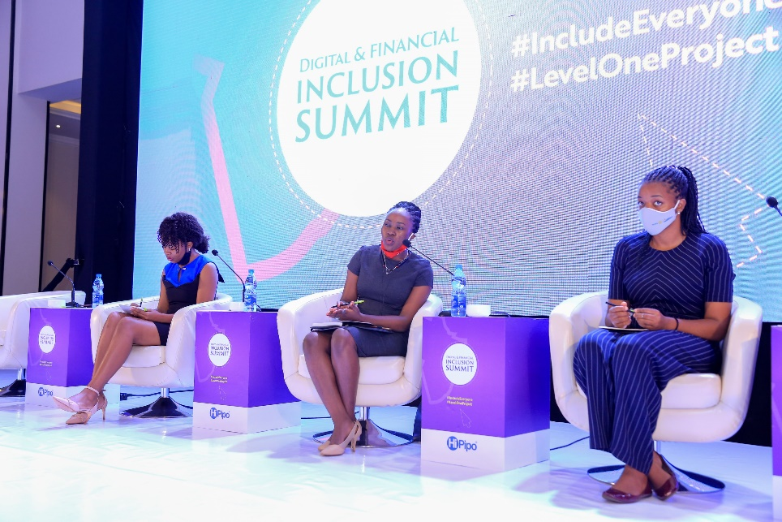
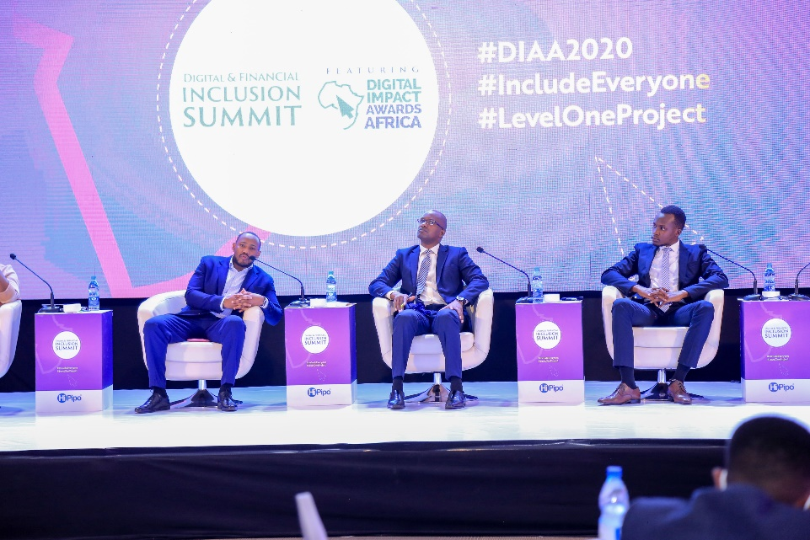
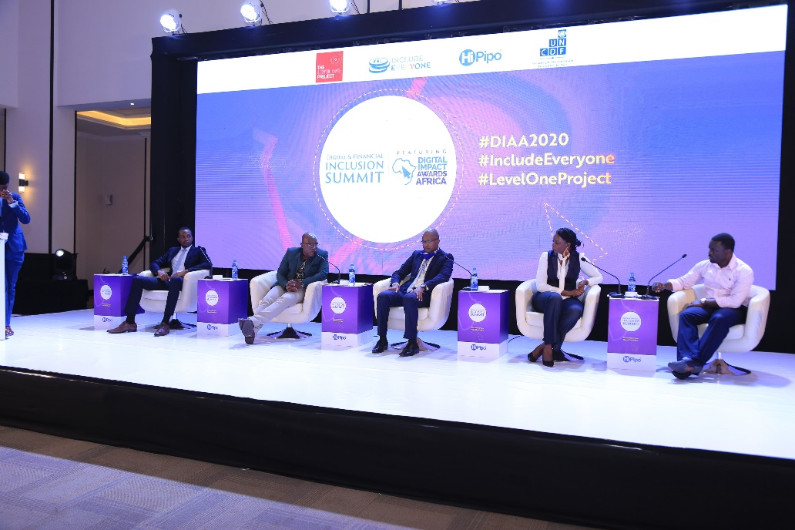
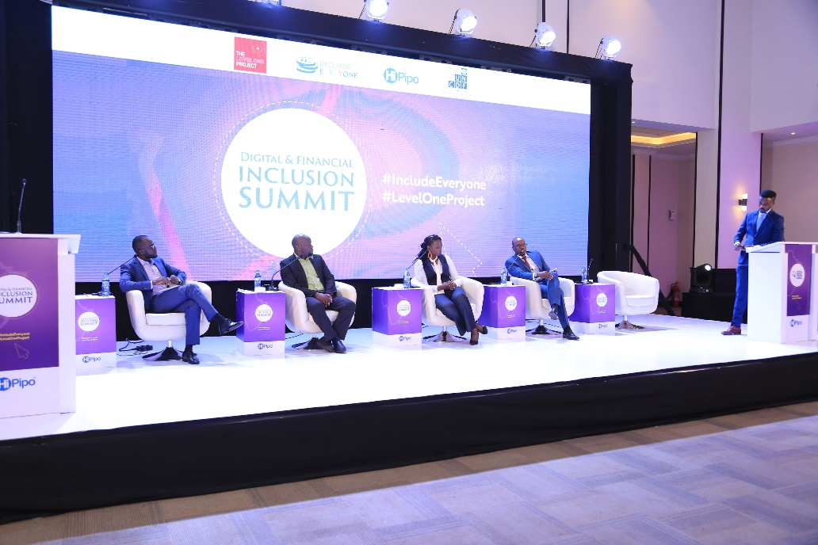
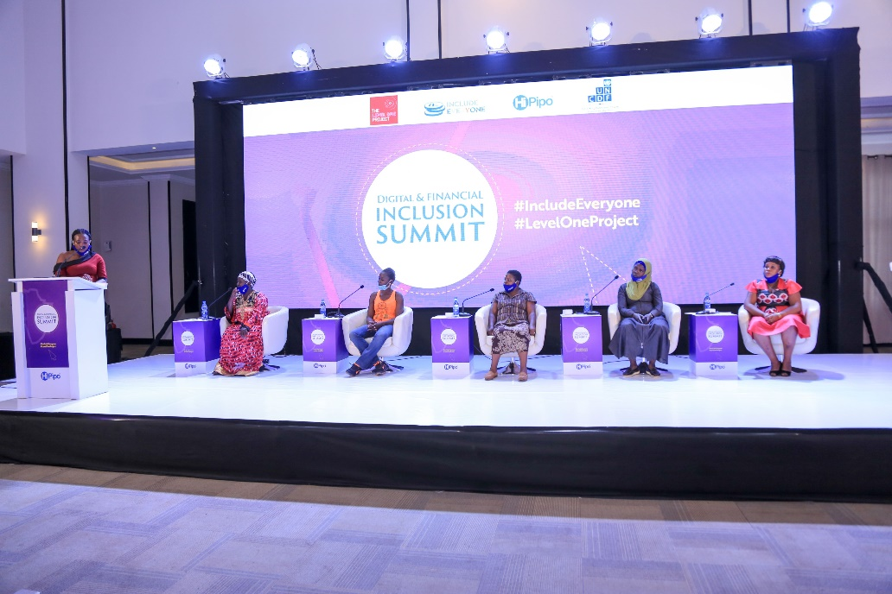
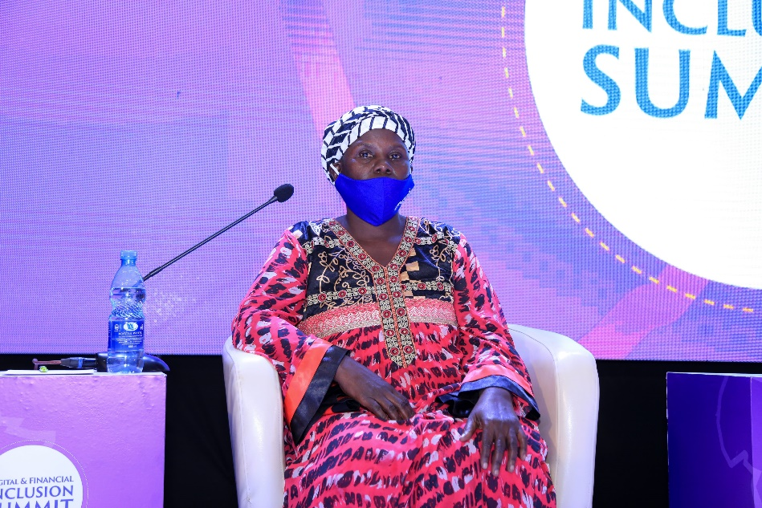
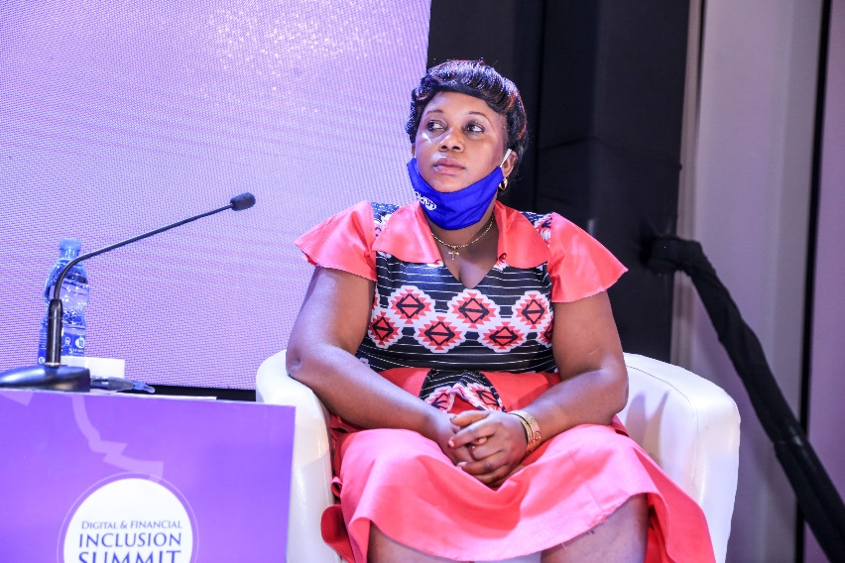
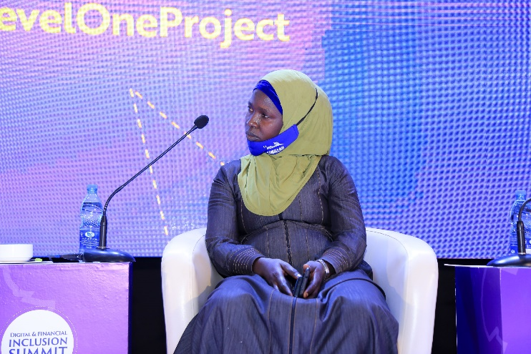
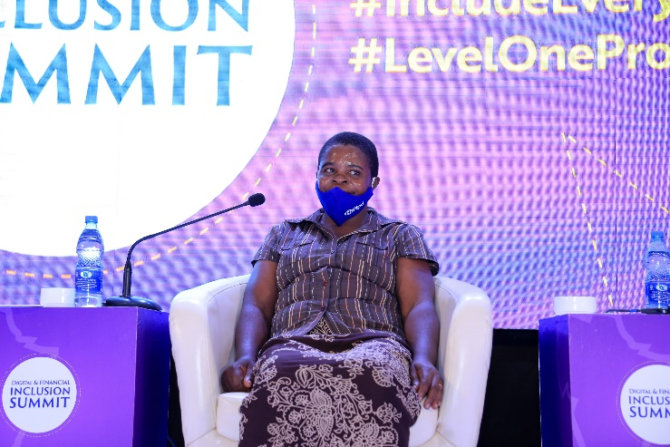
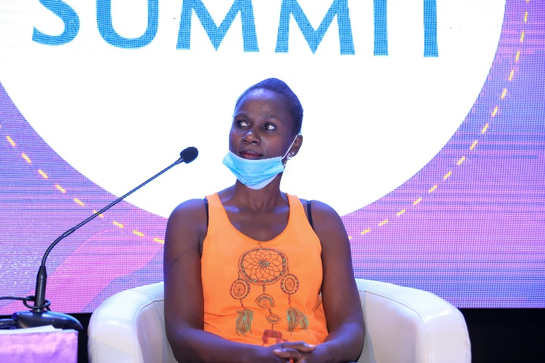

Slide 17









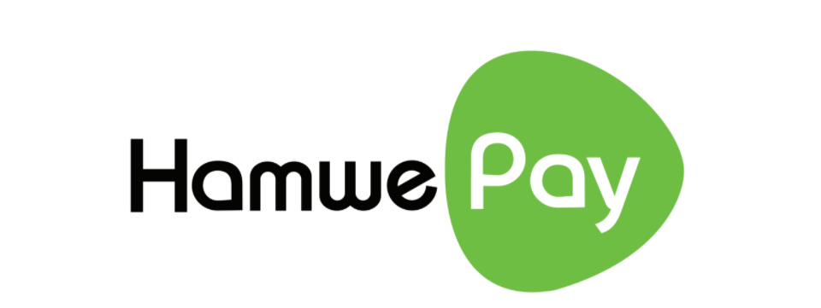













SOME OF THE PARTICIPANTS?

Slide 18
DIGITAL IMPACT AWARDS AFRICA, 2020 - WINNERS
Regulatory Financial Inclusion Rails Award
Bank of Tanzania (BoT): Tanzania Instant Payment System (TIPS)
FinTech Investment and Inspiration Sprinter
PayStack
Best Financial Inclusion Impact
MTN MoMo
Best FinTech: Lending
Jumo
Best FinTech: Remittance
WorldRemit
Best FinTech: Investech
PiggyVest
Best FinTech: InsurTech
AYO
Best FinTech: Blockchain
Sqoin
Best FinTech: Merchant Payments
Flutterwave
Best Healthtech
Carepay
Brand on Social Media Excellence (Consumer Goods)
Movit
Best AgriTech
FarmDrive
Best EduTech
M-Shule
Best Digital Response to Covid Impact
MTN Group #WearItForMe (Diamond)
Safeboda Medical Delivery (Silver)
Best Fintech Solutions Provider
Craft Silicon
Best Digital Financial Services Platform
Comviva – Mobiquity Money
WomenInFinTech – Leadership Award (Personality):
Doreen Lukandwa
Super App Innovation
Ayoba (Diamond )
Safeboda (Silver)
Agritech Innovation Excellence
Hamwe
E-Commerce Innovation Excellence
Jumia
Payments Innovation Excellence
Beyonic
Disruptive Innovation
JPESA -WhatsApp Money
Lending & SACCO Innovation Excellence
Social Lend Africa
Merchant Payments Innovation Excellence
Chapchap
Content Innovation Excellence
YoTV
FinTech Aggregator Excellence
Pegasus Technologies (Diamond)
True African (Gold)
Yo Uganda (Gold)
Beyonic (Platinum)
Craft Silicon (Platinum)
Women Financial Inclusion Award
Pride Microfinance
Digital Banking Excellence
Standard Chartered Bank
Green Energy Innovation Excellence
StarTimes Solar
Digital Customer Experience Excellence (Utilities and Government Services)
NWSC
Best Brand on Social Media (Financial Services, Telecom, IT)
Stanbic Bank
Digital Powered Campaign Excellence
Stanbic National School Championship
Cards Payments Excellence
Stanbic Bank
Community Banking Excellence
Centenary Bank
Digital Brand of the Year
Standard Chartered Bank

Slide 19
Damali Ssali, FCCA, MBA Observations at the HiPipo Digital Impact Awards Africa
26 January 2021

Slide 20
Content Observations Recommendations

Slide 21
Observations – General
I had the pleasure of attending the Digital Impact Awards Africa (DIAA), organised by HiPiPo on 11 December 2020 under the theme Digital Inclusion and Financial Inclusion, Maximising the Digital Dividend.
I had been invited to give the keynote speech at the event titled: Africa to Achieve Full Financial Inclusion by Leveraging Technology.
This was the seventh year that HiPipo had organised the DIAA, and from my perspective as a Ugandan, with a vested interest in trade and financial services, I have witnessed how these events by HiPipo have helped to bring the digital and financial inclusion discussions to the mainstream.
I have seen the Ugandan landscape and policy environment positively move, albeit at a slow pace, towards discussing issues related to inclusive digital technology, thanks to HiPipo.
I also greatly appreciate the partners of HiPipo including the Gates Foundation, Modus Box, Level One Project and the United Nations Capital Development Fund.
There were two panel sessions/discussions that stood out for me at the DIAA.

Slide 22
Observation: Panel session of market women traders discussing e-commerce
This panel session made up of informal women market traders who are based in five busiest markets in Kampala.
The women indicated that the corona pandemic had encouraged them to embrace e-commerce platforms because there were very few customers going to the markets.
However, to their dismay, after selling their foodstuff through the e-commerce platforms, they had to wait two days or sometimes a week to receive payment.
In effect, these women, who are already cash strapped, were giving credit to the e-commerce platforms. As a result, these women decided to abandon the e-commerce platforms. This is unfortunate!
In addition to that the women indicated that the customers requested for items that they may not have, but to fulfil the customer order they would engage with other traders who may have those items.
For example, a women trader normally specialises in one or two products, say tomatoes and onions, however the customer my order for tomatoes, onions, beef and celery. So, the woman who takes the order would engage with the beef seller and the celery seller and take the goods on credit from them.

Slide 23
Observation : Panel session of market women traders discussing e-commerce
As a result, when the women trader who took the customer order does not receive her payment on the same day (and waits for seven days) it means that she can not clear the credit she got from the other traders.
It also means that she can not use the profit from her sold goods to feed her children that day, nor can she sell any more goods to any customer that happens to physically come to her stall.
The fact is that these market women traders often have average capital of barely UGX100,000 (USD30) and they use the profits made daily to buy necessities for their children including food, medicine, and schoolbooks.
Therefore, the more sales they make, through e-commerce platforms, the more profit they would make (if they received the payments on the same day), and therefore the more likely they would be able to contribute to the social and economic welfare of their children.

Slide 24
Observation : Panel session of market women traders discussing e-commerce
Market women represent an important but often ignored segment of society that is involved in informal trade. Informal trade is both domestic informal trade (within the country) and cross-border informal trade (with the neighbouring countries)
Take Uganda for example, in 2019 alone, Uganda’s informal cross border traders exported USD530million worth of goods to the Democratic Republic of Congo, to South Sudan and Kenya. Oover 70% of informal traders are women
Uganda’s domestic informal trade is estimated (very conservative) to be twice as high as the informal cross border trade, at USD1billion.
These trade figures could easily double if inclusive digital and financial solutions are developed and used by the informal domestic and cross border traders!
It is a known fact, and several studies have shown that when a woman has a disposable income, she reinvests 60% back into the business and uses the 40% for her children’s food, healthcare, and education. This is what these informal traders are using the extra income on, the social welfare of the family!
This Ugandan example of the state of informal domestic and cross border trade can be replicated across the African continent, baring in mind that Uganda is a small country when compared to say Ethiopia, Nigeria, DRC.
With the commencement of the implementation of the African Continental Free Trade Area (AfCFTA) in January 2021, it is important that players in the digital and financial services space are aware and appreciate the need to facilitation informal trade given the positive impact that it has on social economic welfare of the continent.

Slide 25
Observation : Panel session discussing the National Payments Systems Act 2020
This panel session was made up of players from the fintech industry and policy makers.
On the main issue discussed was the fact that the National Payment System Act 2020 was going to curtail the development of the fintech industry in Uganda because it has very stringent minimum capital requirements.
They argued that these capital requirements will limit the number new entrants in the industry and at the same time allow the existing large players to monopolise the fintech space. The players in the fintech space all complained about that fact that they were not fully consulted by the policy makers when the Act was being developed.
To put this into the context, from my perspective, this Act is going to rather curtail and constrain the number of players in the country’s fintech space.
Therefore, this space will be dominated by the large players, who because of the this almost monopolistic domination, will continue to provide services that are not inclusive to certain segments of the society such as the domestic and cross border informal traders, mostly women.

Slide 26
Recommendations
Capacity building for market women traders: There is need to for capacity building for market women to give them the tools: (a) to be able to advocate for themselves and appropriately negotiate with e-commerce players to ensure same day same settle; and (b) engage with policy makers so that the policies developed are responsive to the needs of most vulnerable in the society, especially women.
Support Women in Fintech (WiF): The WiF need to be supported with financing (seed capital) so that they can develop fintech solutions that are responsive to the needs of women, such as the market women traders. During the WIF Hackathon that was conducted, in September 2020 by HiPiPo, the top challenge sited by women developers was a lack of capital to get their solutions to the market.
Facilitate policy discussions with all stakeholders: There is need for stakeholder engagements between policy makers, fintech solution providers and fintech beneficiaries (such as the market women traders) to ensure that the policies and regulations that are passed, such as the National Payments Systems Act 2020, simultaneously facilitate, rather than curtail the fintech industry and catalyse the social economic welfare of women traders.

Slide 27
Mwebale Nyo Nyo! Thank you so much!

Slide 28
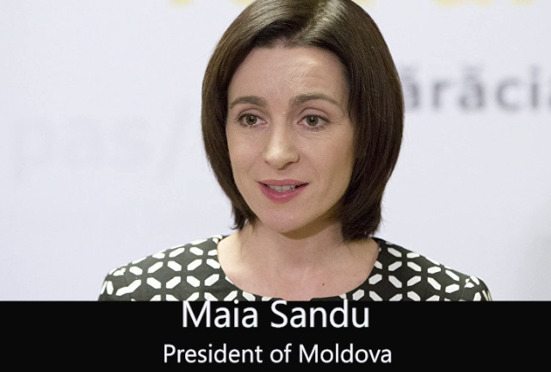
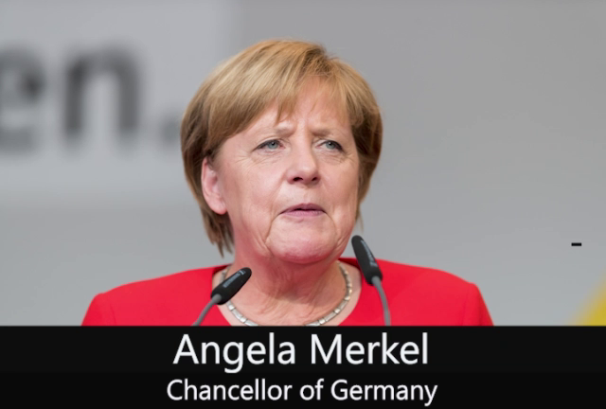
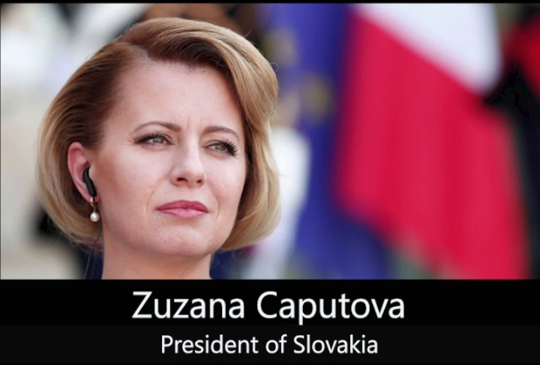
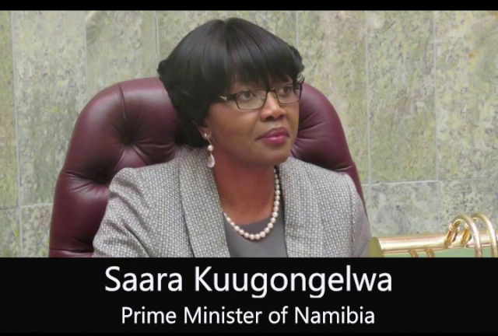
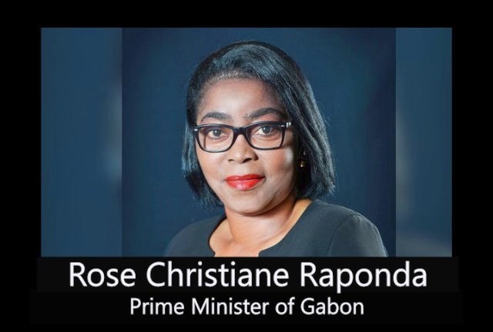
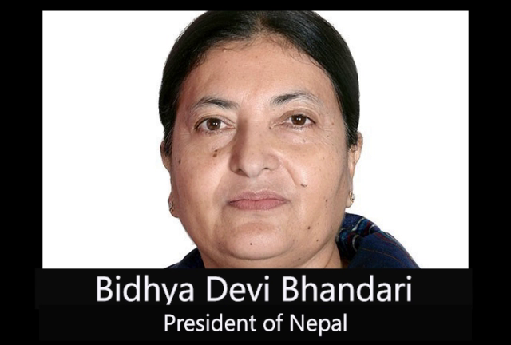
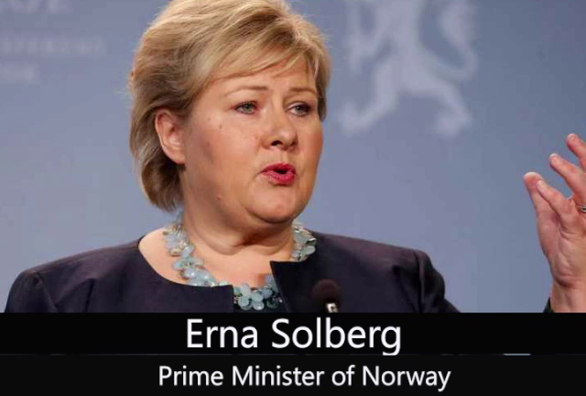
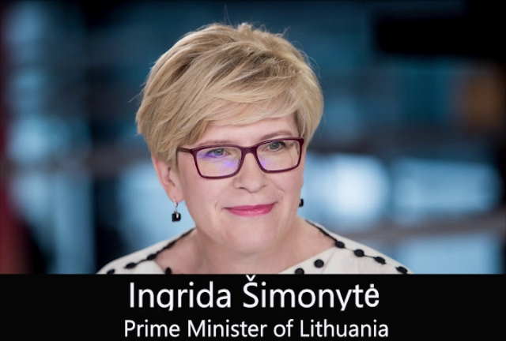
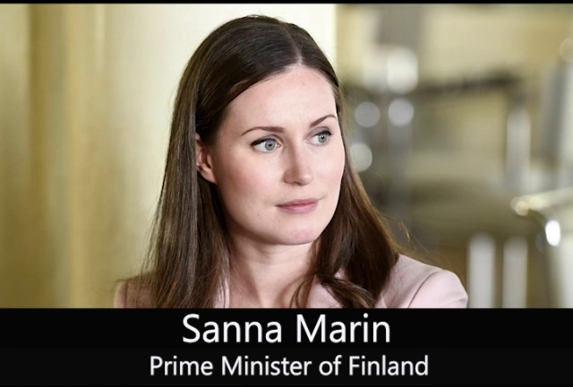
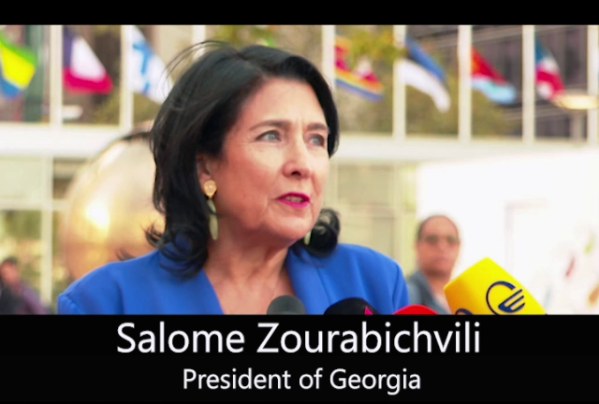
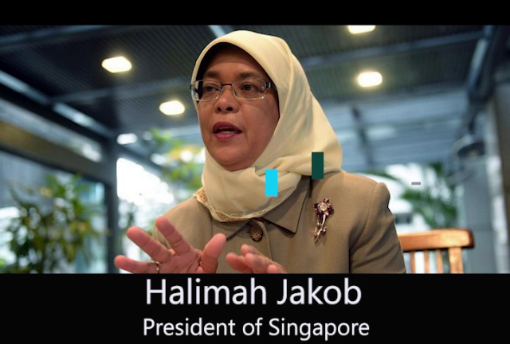
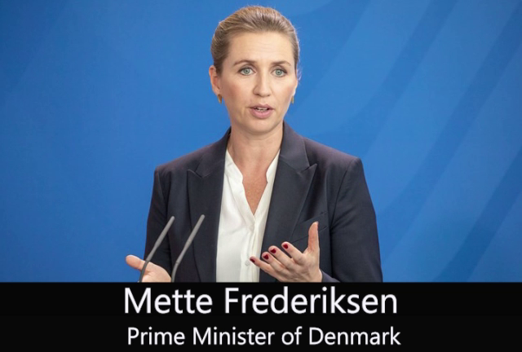
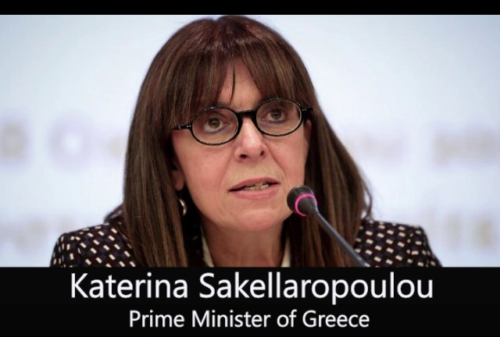
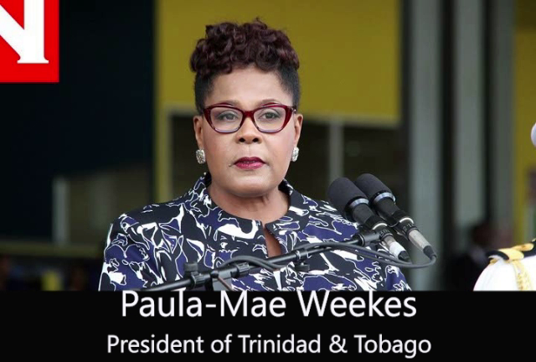
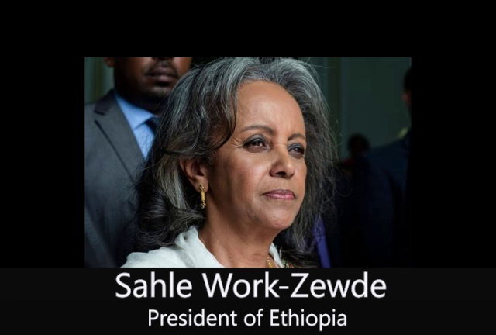
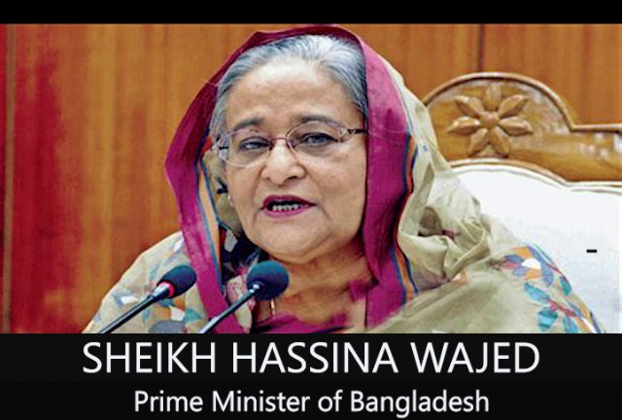
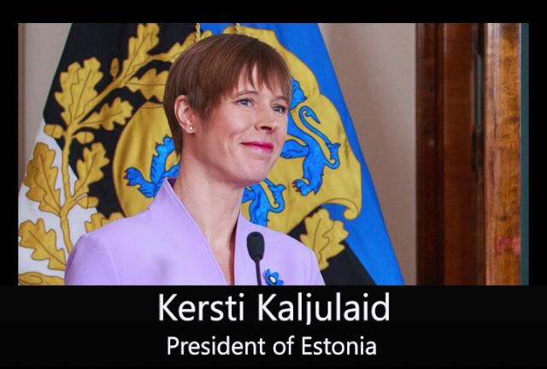
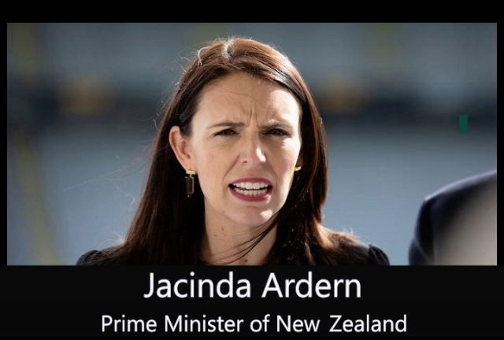
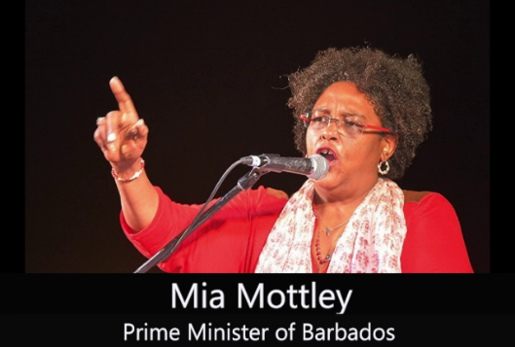
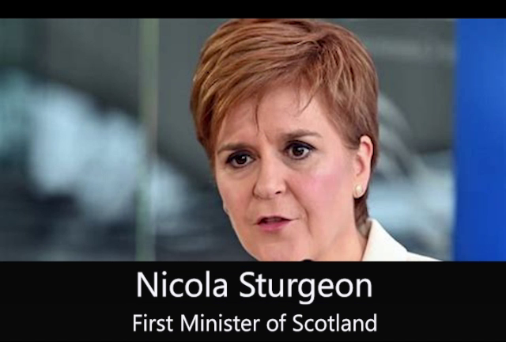
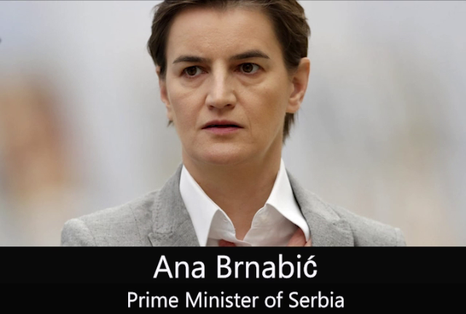
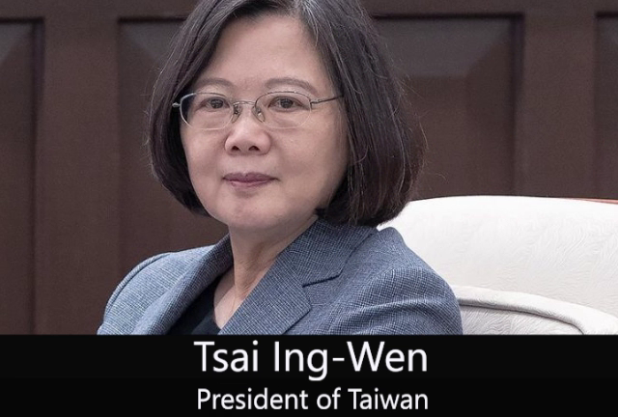
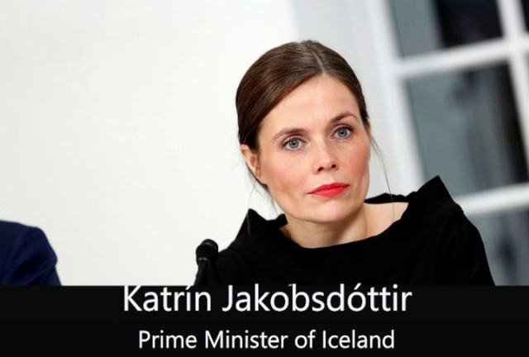
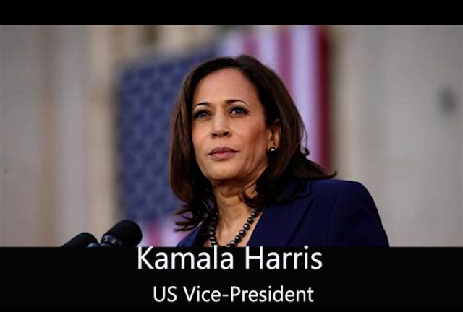
WHILE THE WORLD HAS BEEN DISTRACTED BY THE NOISE OF ALL THOSE RESISTANT TO CHANGE, CHANGE HAS BEEN HAPPENING ANYWAY….

Slide 29
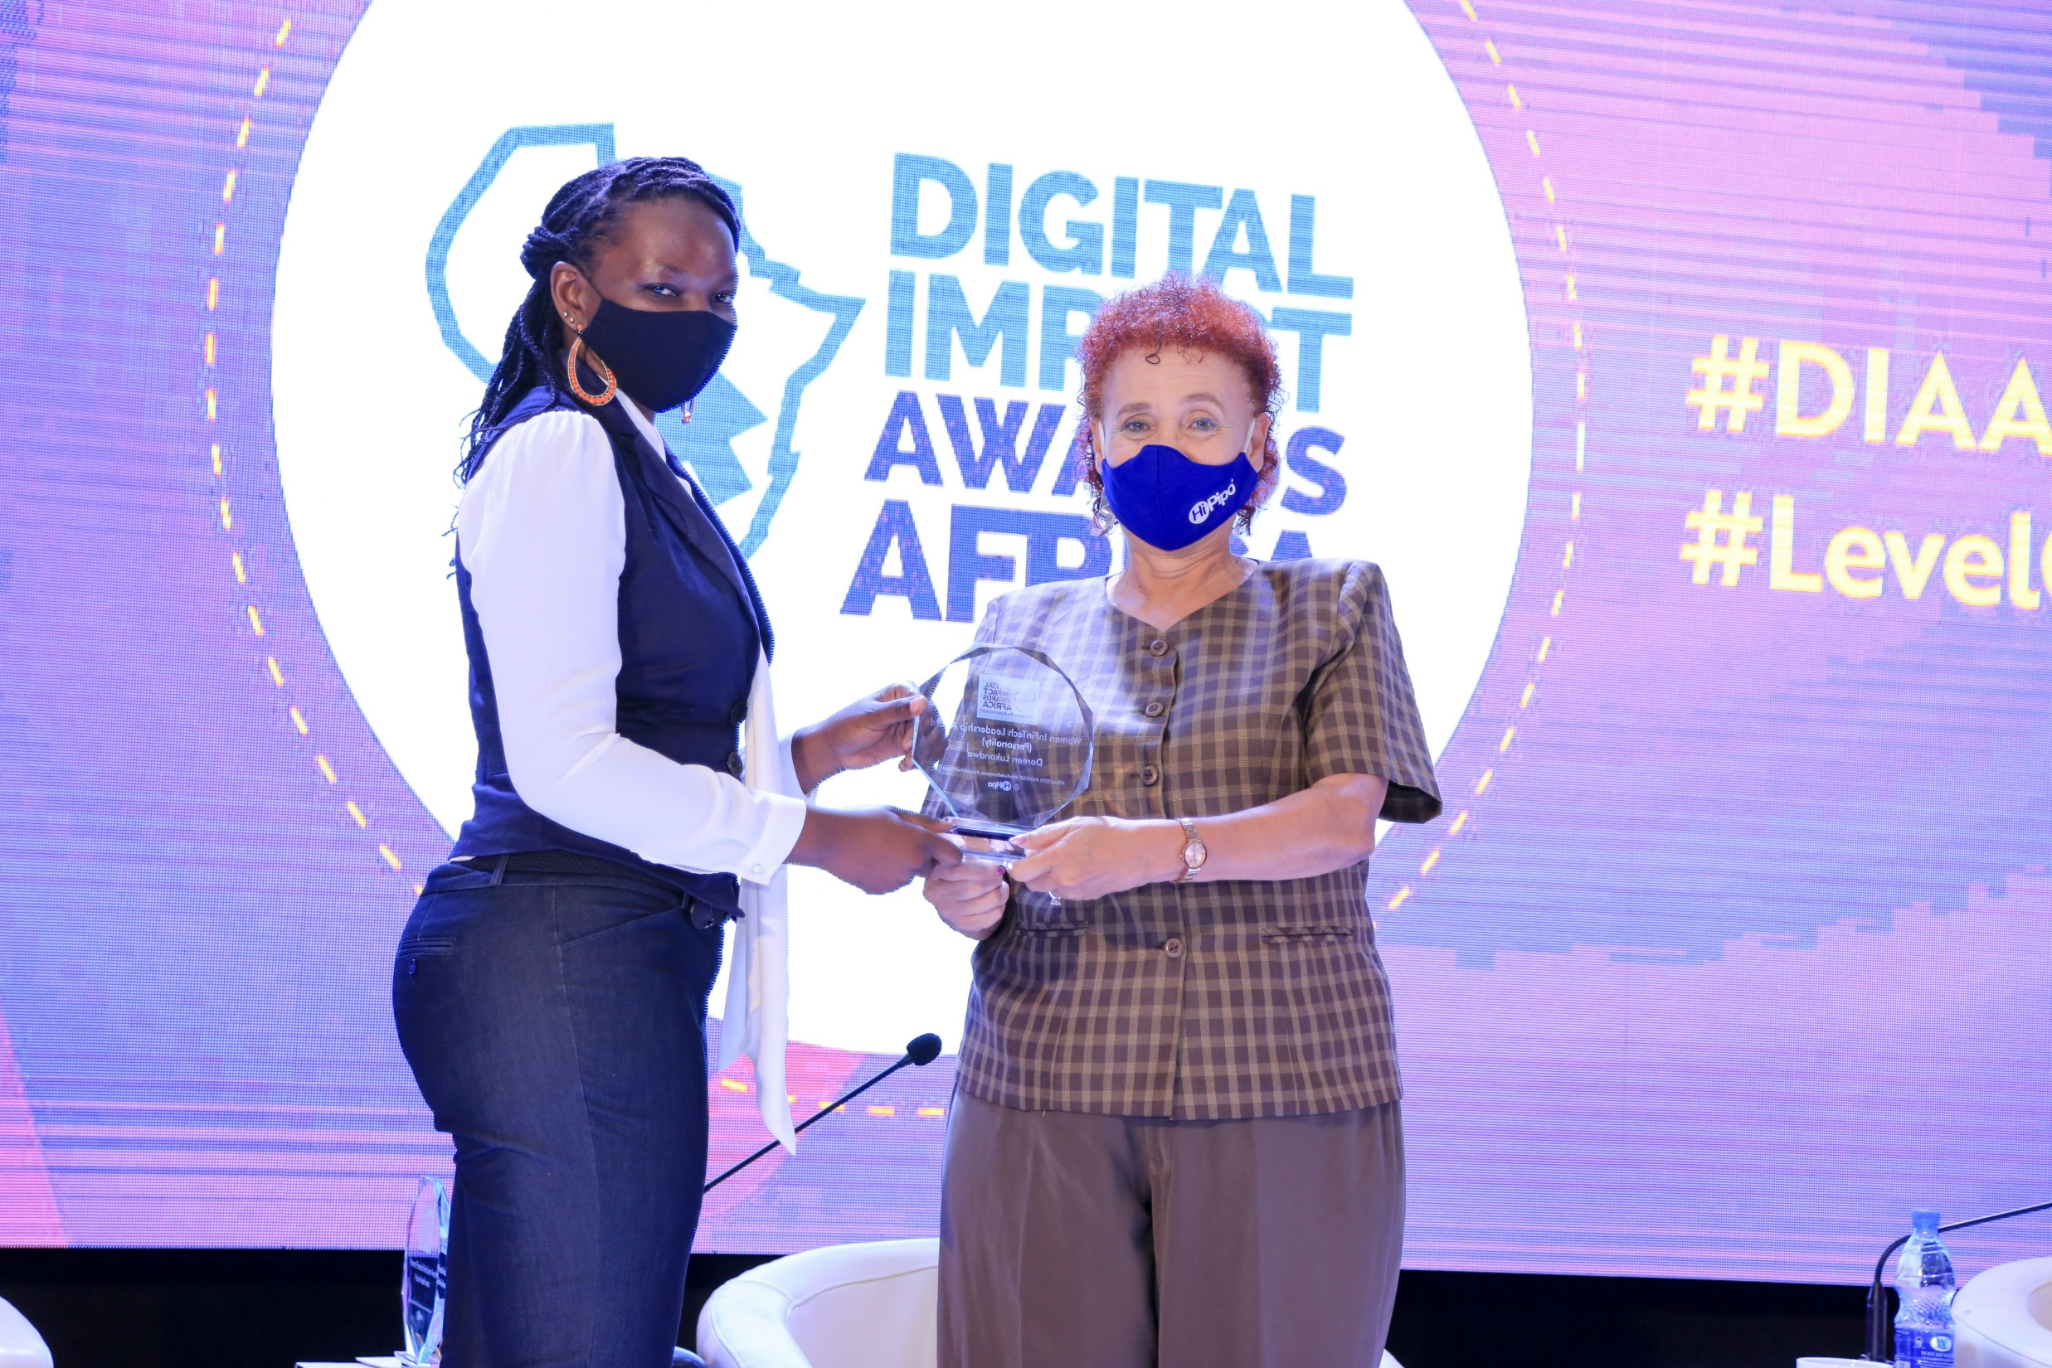
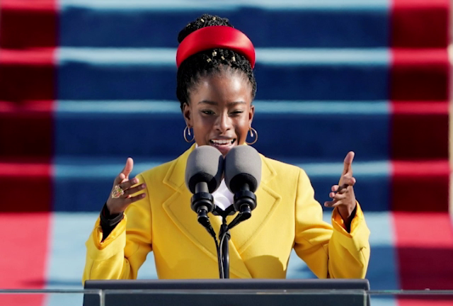
EMPOWER WOMEN AND CHANGE THE WORLD.
THE WOMEN ARE COMING...

Slide 30
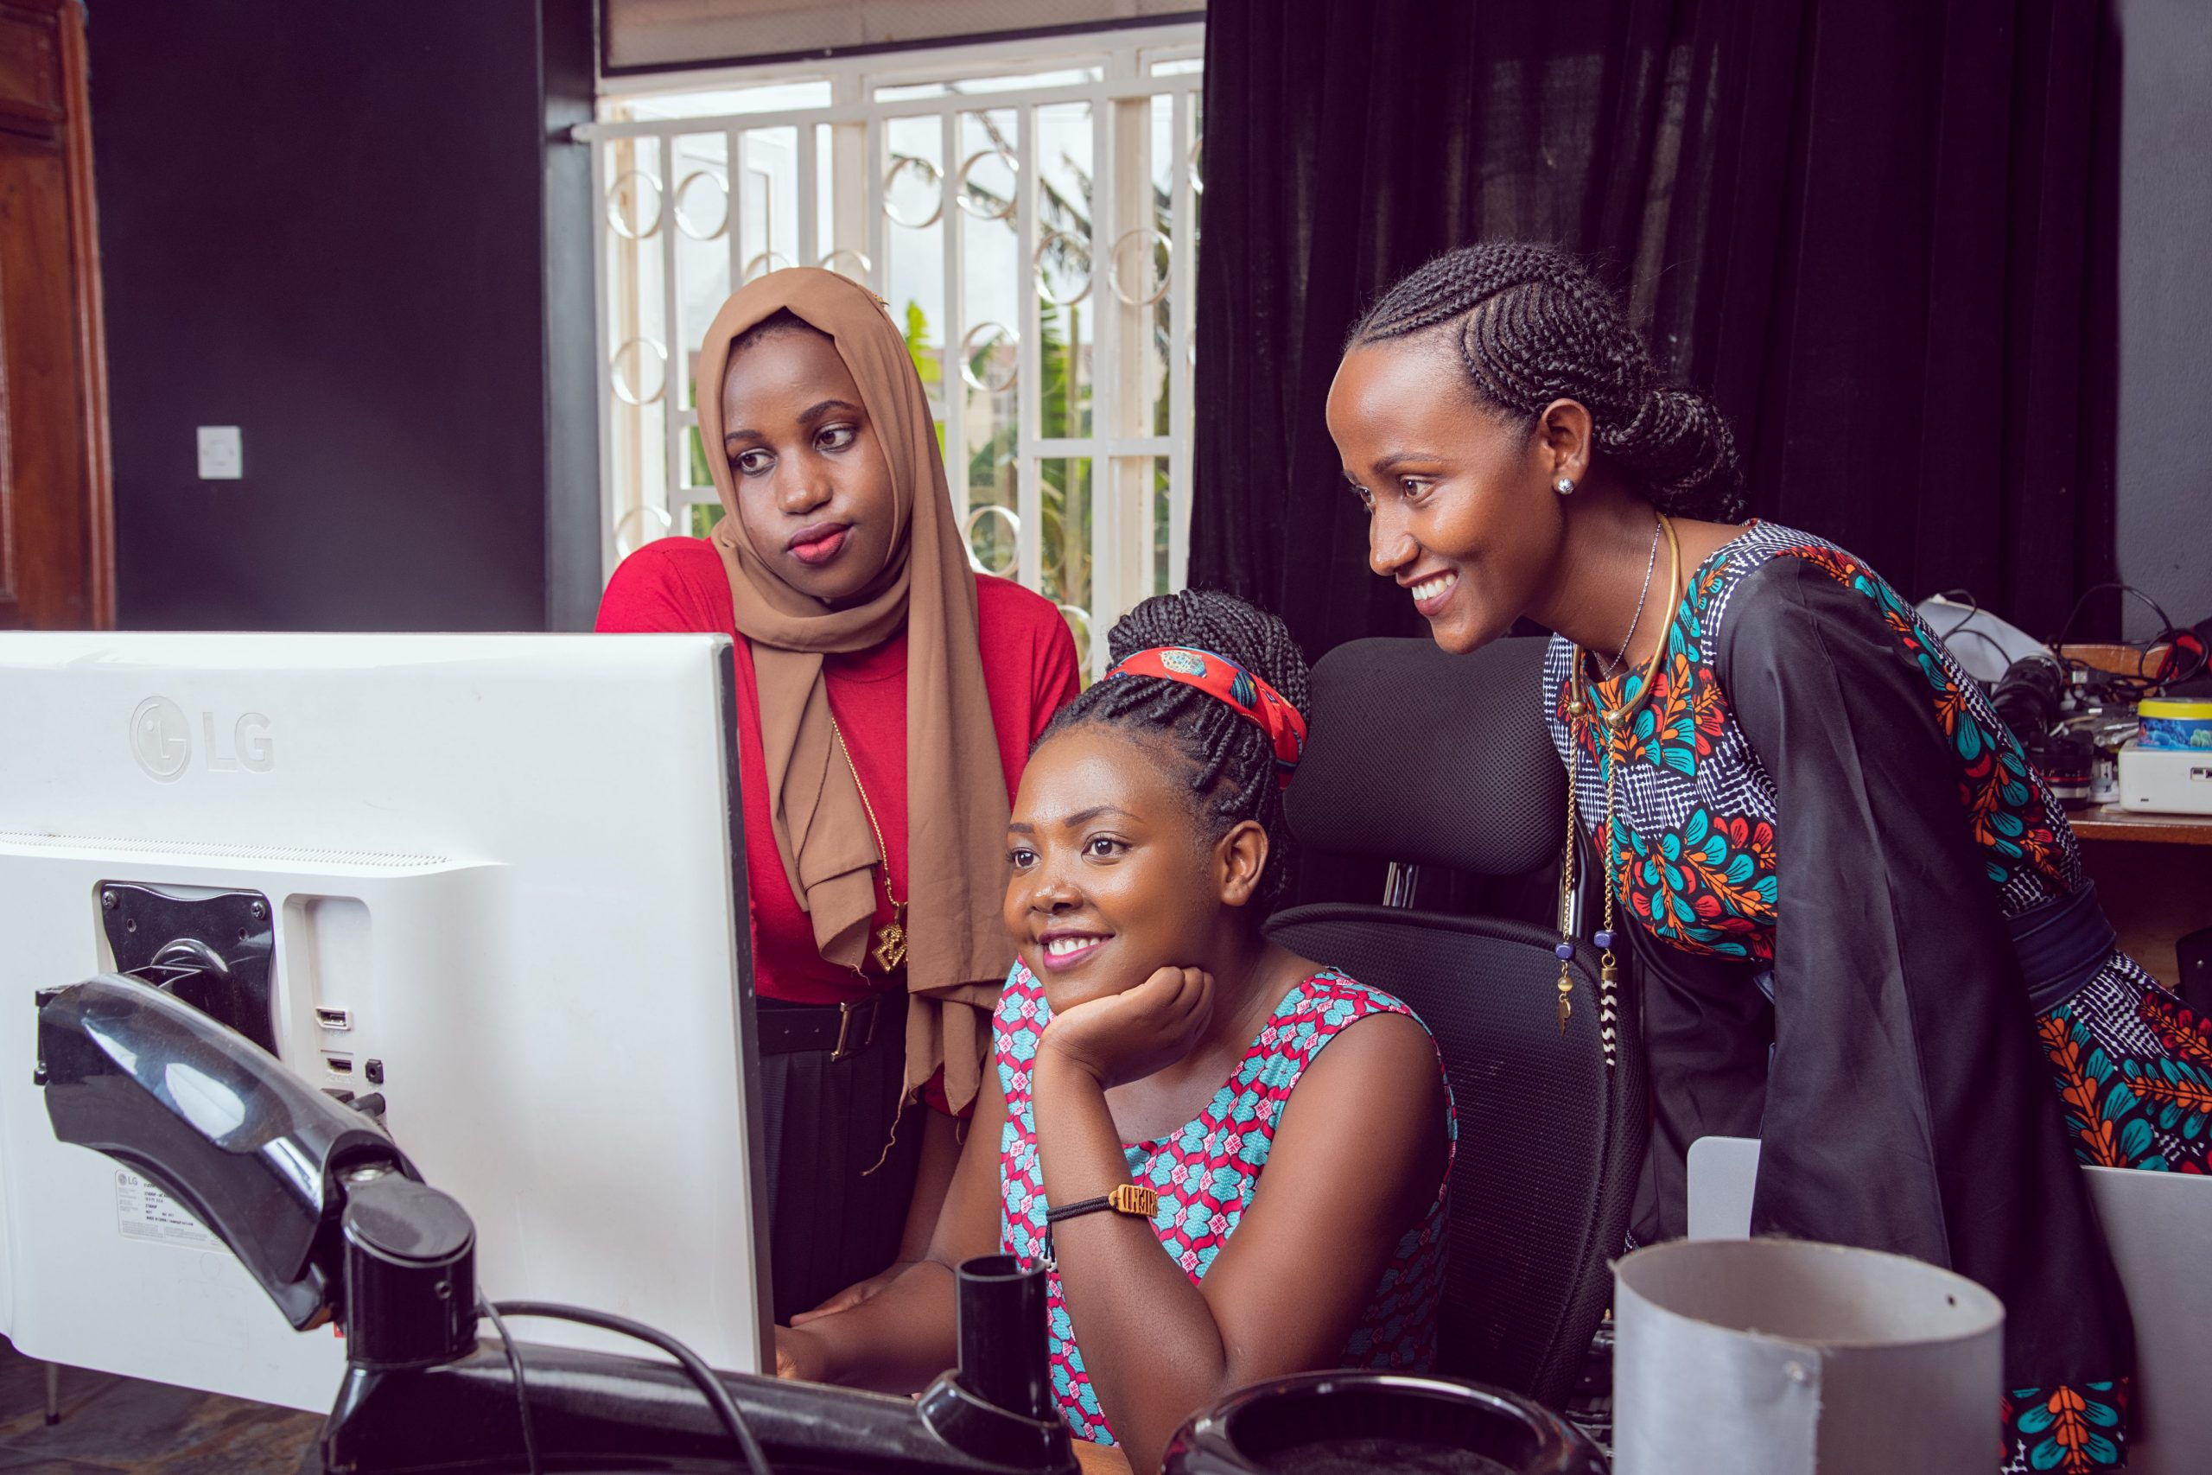
TAKE SOMETIME TO WATCH THE
INAUGURAL WOMEN IN FINTECH
DOCUMENTARY
https://www.youtube.com/watch?v=J1eNBqtn2Ms

Slide 31

Thank You to our Sponsors The Bill & Melinda Gates Foundation.
Contact US
Innocent@HiPipo.com
socialweb@HiPipo.com

Slide 32
Thank you!

